Slide 1
Faculty Orientation: Overview of UHV-I in Student Induction Program
For Faculty and Student Buddies who are Volunteering in SIP

Slide 2
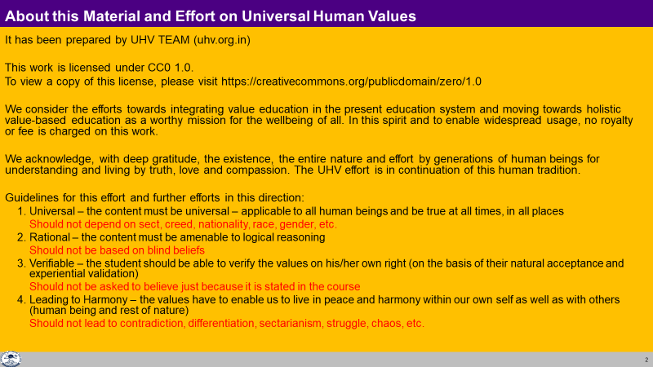

Slide 3
Background
Students entering college today have come through intense academic pressure—entrance exams, coaching, competition—and often feel disconnected from social life, community, and even themselves.
Now that they are entering higher education, it's not just about acquiring knowledge in their chosen field. They need to evolve as well-rounded human beings with clarity about life, relationships, society, and the world.
That’s why SIP was designed—to smooth this transition.
At the heart of SIP lies UHV-I.

Slide 4
The UHV-I Module
It encourages self-exploration:
Every student can reach to their full potential as a human being… live a fulfilling life of continuous happiness with prosperity
For this, we have to understand
Ourselves (our aspirations, concerns…), other people, other things around with which we interact…
Our relationships, our participation – with oneself, with other people, in society, in the entire nature/existence
It is possible to understand – because
The need to understand is innate in every human being and
The potential to understand is intrinsic to human being
The things essential to understand are definite
We only place some proposals before the student; S(he) self-explores – verifies on the basis of natural acceptance and experientially validates in living…
UHV is an exploration into it, so that the student can discover their full human potential, develop a holistic plan for realising it and take steps towards it

Slide 5
It has been seen that UHV-I helps to
see the need for developing a holistic, humane world-vision
sensitise the student about the scope of life
individual human being
family (inter-personal relationship)
society
nature/existence
Strengthen self-exploration
develop more confidence and commitment to understand, learn, and act accordingly
Now let’s look into the 15 modules

Slide 6
What is included in this Presentation (and documented in the UHV-I Mentor Manual)
The Student Induction Initial 21 days
Program UHV-I is the core module
Faculty Mentorship One UHV faculty mentor (guardian, guide from same department)
Program for every 20 newly joined students
Weekly interaction
Mentorship throughout period of study (e.g., 4 years for BTech)
Student Buddy Program One senior student (elder sibling)
for every 5 newly joined students
Weekly interaction
The UHV-I Module 15 facilitator-led discussions of 1½ hours each (total 22½ hours)
How to Conduct UHV-I
Resources
UHV-I is intended to provide a glimpse of universal human values,
and help the student explore that going by human values leads to fulfilment of right aspirations and the resolution of concerns, ultimately living with fulfilment (in all aspects of life)

Slide 7
Student Induction Program – Context
New entrants go through years of strenuous preparation and get accustomed to it.
Often they lose the connection from social life and recreational activities
On the other hand, higher education, like engineering, demands a personality in all dimensions
The Student Induction Program is designed for a smooth transition
from school, preparation environment to higher education
Preparation
Bachelor’s Program
Induction
For Initial 21 Days
UHV Cell
For Remaining 4 Years
Notes:
Students entering college today have come through intense academic pressure—entrance exams, coaching, competition—and often feel disconnected from social life, community, and even themselves.
Now that they are entering higher education, it's not just about acquiring knowledge in their chosen field. They need to evolve as well-rounded human beings with clarity about life, relationships, society, and the world.
That’s why SIP was designed—to smoothen this transition. And at the heart of SIP lies UHV-I.

Slide 8
Goals of SIP
To become familiar with the ethos and culture of the new surroundings
To develop bonds with peers, seniors, faculty and staff
To provide an exposure to a holistic vision of life (based on larger national and human good; or the well-being of all)
Develop awareness, sensitivity and understanding of the
Self---family---Society---Nation---International---Entire Nature
To develop a healthy lifestyle and ethical professional discipline
To connect and appreciate the diversity of cultures
To overcome weaknesses in some essential professional skills to be ready for higher study (only for those who need, e.g., mathematics, languages/communication)

Slide 9
Universal Approach
All the SIP activities (modules) are based on generic and universal principles
Local, regional, national and international examples are taken so that students can relate them to their day to day life
For example, module 2 is about “physical health and related activities”. In this, we will be talking about “holistic human health” which is generic and universal. To exemplify this, we may take the example of Ayurved.
For example: We want to live with fulfilment as a society. This part is common, universal. To exemplify this, we may expose students to traditional Indian culture and philosophy as well as contemporary western culture
In this way:
It will help in connecting the basic principles through specific examples
It will help the student to see and appreciate various cultures, to see the commonality amongst them
It will help to evaluate any specific example, system or culture, with a view to fill the gaps, rather than to criticise or reject it. Further, we can also be mutually enriching for other cultures

Slide 10
Solution Centric Approach
The world today has become a mixture of various cultures
In India, we can see
Urban / City culture  Western culture
Liberal culture  Movie/Internet culture
Traditional rural Indian culture
and so many others
Today, the problem is that one culture tends to compare with other cultures and be opposed to them. This is because their basic assumptions and therefore thoughts are different. Even though there are commonalities at the core, the conflict is at the level of expression and details
With this situation, it is imperative to
Appreciate the different approaches and achievements
(to whatever extent a culture has realised the basic human values of truth, love and compassion at the core)
Be complimentary, help to fill the gaps, rather than to compare, criticise or reject

Slide 11

Inaugural Ceremony ~2 hours
M1: Universal Human Values I (UHV-I) 15-25
M2: Physical Health and Related Activities 35-50
M4: Visit to a Local Area 03-05
M5: Lectures by Eminent People 02-05
M7: Literature / Literary Activities 15-30
M8: Creative Practices 30-36
M9: Other co-curricular Activities 05-10
M3: Familiarization of Dept/ Branch and Innov 02-05
M6: Proficiency Modules 05-15
Grand Celebration 02-06
SIP Activities
Universal Human Values (UHV) Foundation
Indian Knowledge System (IKS)
including local, regional, national
international examples
focused on wellbeing of all
3 Weeks
Nature friendly and
human friendly skills and
their practice

Slide 12
UHV-I Module
UHV-I is intended to provide a glimpse of universal human values,
and help the student explore that going by human values leads to living a fulfilling life
(in all aspects of life)

Slide 13
UHV Module
In the UHV Module of SIP, the main points to highlight are:
Every student has the possibility to reach to their full potential as a human being
For this, we have to understand
Ourselves (our aspirations, concerns…), other people, other things around with which we interact…
Our relationships, our participation – with oneself, with other people, in society, in the entire nature/existence
It is possible to understand – because
The need to understand is innate in every human being and
The potential to understand is intrinsic to human being
The things essential to understand are definite
We will use a process of self-exploration for this… we simply have to pay attention, and explore into the proposals… Let the time in this institution be a time of intense and joyous exploration!
UHV is an exploration into it, so that the student can discover their full human potential, develop a holistic plan for realising it and take steps towards it

Slide 14
UHV Module
Discover our aspirations and articulate our concerns
We can slowly realise that
We all have the same basic aspirations
We have to understand to fulfil our aspirations
We all have some concerns, some problems, These can be different for different students
To resolve any problem or concern also, we need to understand
The process to understand is simply to pay attention. We can easily do that. We can understand, realise our aspirations and resolve our concerns
E,g, Find out if it is true that “whatever you have paid attention to has revealed itself to you”. E.g. maths seemed so difficult, but now you know it… because you paid attention to it
In this UHV module, we will go over this process at four levels
Individual human being, family, society and nature/existence

Slide 15
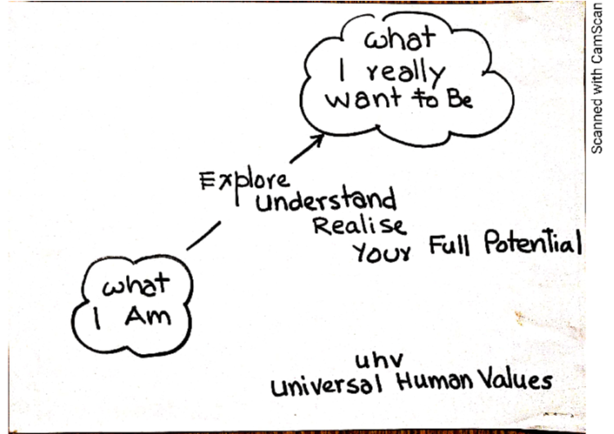
Aspirations (what you want to achieve)
Regarding self, as an individual
About family, friends, other people
Related to society, societal systems
In the natural environment
My Full Potential
Concerns (what you want to get rid of)
Regarding self, as an individual
About family, friends, other people
Related to society, societal systems
In the natural environment

Slide 16
The objectives of the UHV module (UHV-I) are:
To help the student to see the need for developing a holistic, humane world-vision
To sensitise the student about the scope of life
individual human being
family (inter-personal relationship)
society
nature/existence
Strengthening self-exploration
To develop more confidence and commitment to understand, learn, and act accordingly

Slide 17
UHV-I An Orientation to Universal Human Values
Understanding My Full Human Potential

Slide 18
UHV-I: An Orientation to Universal Human Values (Understanding the Full Human Potential)
Session | Title | Underlying Reality
Ind 1 | Introduction Welcome, course overview, getting to know each other
Ind 2 | Exploring our aspirations and concerns Planning for a fulfilling life by relating academic success, career… expectations of family, peers… to our basic aspiration… | Basic human aspiration Being vs doing
Ind 3 | Basic human aspiration and its fulfilment Setting correct priorities in life | Human consciousness Prioritising right understanding, relationship, physical facility
Ind 4 | Program for fulfilment of basic human aspiration Shifting from excitement to happiness… | Understanding harmony Happiness and prosperity
Ind 5 | Fulfilment of aspirations at individual level Distinguishing between the needs of Self and Body | Harmony in human being
Ind 6 | Resolution of concerns at individual level Developing self-confidence, overcoming peer pressure | Harmony in the Self 3 sources of imagination
Ind 7 | Ensuring health holistically Making a definite program for health | Harmony between Self and Body
Notes:
Getting to know each othe
Basic human aspiration – root cause of problems = not being clear of basic aspiration, not making effort to realise our basic aspiration
Three distinct things required to fulfil basic aspiration in a certain priority
Harmony = happiness. Excitement-escape loop is never ending. Move to harmony
Clarity of human being – clarity of needs and their fulfilment
Awareness of the Self, of the NA in the self is the source of self-development
With awareness, we can ensure health holistically – body, self, environment

Slide 19
UHV-I: An Orientation to Universal Human Values (Understanding the Full Human Potential)
Session | Title | Underlying Reality
Ind 8 | Fulfilment in relationship – Trust Resolving anger, irritation, fear… | Harmony in family
Ind 9 | Fulfilment in relationship – Trust Shifting from reaction to response in relationship… | Harmony in family
Ind 10 | Fulfilment in relationship – Respect Shifting from differentiation to complementarity… | Harmony in family
Ind 11 | Fulfilment in relationship – Other Feelings Shifting from competition to excellence, infatuation to love… | Harmony in family
Ind 12 | Understanding our role in society Contributing towards fulfilment of a common human goal in the society (institution… state… nation… world) | Harmony in society
Ind 13 | Understanding our role in nature Contributing towards harmony in nature | Harmony in nature/existence
Ind 14 | Sum up and program
Ind 15 | Sharing, self-evaluation
Notes:
8. Feeling of trust on intention – feeling of relationship and resolution of concerns like anger, irritation and fear
9. Shifting from reaction to response
10. Respect – complementarity, resolving differentiation
11. gratitude, shifting from competition (opposition) to excellence (glory, reverence), infatuation to love
12. Common human goal, only if responsible families contribute, the common goal can be fulfilled
13. Our physical needs come from rest of nature. Mutual prosperity only if responsible families contribute to maintaining the harmony in nature
14. For a fulfilling life, we need to decide with wellbeing of all as the basic criteria – need a holistic world-vision for that.

Slide 20
Programs Following UHV-I
UHV-I 15 Session Introduction to Universal Human Values
(part of the Student Induction Program during initial 21 days)
Faculty Mentorship One UHV faculty mentor (guardian, guide from same department)
Program for every 20 newly joined students
Weekly interaction
Mentorship throughout period of study (e.g., 4 years for BTech)
Student Buddy Program One senior student (elder sibling)
for every 5 newly joined students
Weekly interaction
UHV-I is intended to provide a glimpse of universal human values,
and help the student explore that going by human values leads to fulfilment of right aspirations and the resolution of concerns, ultimately living with fulfilment (in all aspects of life)

Slide 21
Model Schedule for UHV-I FDP (to prepare faculty to teach UHV-I, Pre-req: UHV-Intro FDP)
Pre Session 8.30-9.00 | Session 1 9.00-10.30 | Session 2 11.00-12.30 | Session 3 13.30-15.00 | Session 4 15.15-16.45 | Session 5 16.50-18.00
Inauguration | Ind 0: UHV-I Overview Ind 1: Introductions Ind 2: Exploring Aspirations and Concerns | Ind 3: Basic human aspiration and its fulfilment Ind 4: Program for fulfilment of basic human aspiration | Ind 5: Fulfilment of aspirations at individual level Ind 6: Resolution of concerns at individual level | Ind 7: Ensuring Health How to Share Values (from Mentor Manual) | Demo Presentations
Sharing, Q&A | Ind 8: Fulfilment in Relationship – Trust Shifting from Reaction to Response | Ind 9: Fulfilment in Relationship – Respect Ind 10: Shifting from Competition to Excellence | Demo Presentations | Ind 11: Fulfilment in Relationship – Gratitude… Love | Demo Presentations
Sharing, Q&A | Ind 12: Understanding Role in Society | Ind 13: Role in the Natural Environment Ind 14: Sum-up & Future Program | Demo Presentations | Ind 15: Self-evaluation | Valedictory Function

Slide 22
How to Conduct UHV-I
An Overview
15 sessions of 1 to 1.5 hours each

Slide 23
Note to Faculty
In the SIP, the main points we want to highlight are:
Every student has the possibility to reach to their full potential as a human being
For this, we have to understand
Ourselves (our aspirations, concerns…), other people, other things around with which we interact…
Our relationships – with oneself, with other people, other things around us…
It is possible to understand – because
The need to understand is innate in every human being and
The potential to understand is intrinsic to human being
The essential things to understand are definite
We will use a process of self-exploration for this… we simply have to pay attention, and explore into the proposals… Let the time in this institution be a time of intense and joyous exploration!
UHV is an exploration into it, so that the student can discover their full human potential, develop a holistic plan for realising it and take some steps towards it

Slide 24
Note to Faculty (cont.)
For this we will try to
Discover our aspirations and articulate our concerns
We can slowly realise that
We all have the same basic aspirations
We have to understand to fulfil our aspirations
We all have some concerns, some problems, These can be different for different students
To resolve any problem or concern also, we need to understand
The process to understand is simply to pay attention. We can easily do that. We can understand, realise our aspirations and resolve our concerns
E,g, Find out if it is true that “whatever you have paid attention to has revealed itself to you”. E.g. maths seemed so difficult, but now you know it… because you paid attention to it
In this UHV module, we will go over this process at four levels
Individual, family, society and nature

Slide 25
Aspirations (what you want to achieve)
Regarding self, as an individual
About family, friends, other people
Related to society, societal systems
In the natural environment
My Full Potential
Concerns (what you want to get rid of)
Regarding self, as an individual
About family, friends, other people
Related to society, societal systems
In the natural environment

Slide 26
General Guidelines
Conduct 15 sessions of 1.5 hours each in face-to-face mode in small groups of 20 students (only if not possible, use larger groups, shorter sessions or online mode)
Ensure that the guidelines (universal, rational, verifiable, leading to harmony)
Connect their real life, their aspirations and concerns with the basic reality (underlying harmony). This will help students to develop interest in understanding
Keep the discussion live, natural and interactive (not instructive, made-up, artificial…)
Propose, encourage exploration (not preach, try to convince, get students to “agree”…)
Have continuity from one session to another, overall (not independent unconnected…)
Prepare well
Note specific suggestions for refinement
More details in UHV-I Mentor Manual

Slide 27
eSIP Recordings 2020
English: https://www.youtube.com/watch?v=OgdNx0X923I&list=PLYwzG2fd7hzer-n_sVjmtFnuSs_Mph4Bi
Hindi: https://www.youtube.com/watch?v=nBdLaFUlO8E&list=PLYwzG2fd7hzeSdsr3W9-8B6mFlx-FIsgB

Slide 28
Resources for Preparing

Slide 29
UHV-I Materials for your Preparation
Materials
UHV-I Presentations
UHV-I Mentor Manual
Surveys, Videos and Assignments
Recordings on YouTube
Reference Text Book and Teachers’ Manual
Further Activities
Higher Level FDPs
Volunteering
Weekly RP Development Meetings
Weekly Mentor-Mentee Meetings
The Morning Session

Slide 30
UHV-I Materials
Links
AICTE FDP-SI Website https://fdp-si.aicte-india.org/
SIP YouTube Channel https://www.youtube.com/@aicte-sip1598
UHV Website https://www.uhv.org.in/
UHV Youtube Channel https://www.youtube.com/@UniversalHumanValues
Presentations, Surveys and Assignments
https://drive.google.com/drive/folders/1016XJBOvMgE1DqLW2pBsb2r6Izbtqzmu?usp=sharing
Preparing to Share Values
https://www.youtube.com/watch?v=vbvPkZ8X4d8&list=PLWDeKF97v9SOkLsFSULd2l6tQ4PRxyvRo
Hindi Recording
https://www.youtube.com/watch?v=nBdLaFUlO8E&list=PLYwzG2fd7hzeSdsr3W9-8B6mFlx-FIsgB
English Recording
https://www.youtube.com/watch?v=OgdNx0X923I&list=PLYwzG2fd7hzer-n_sVjmtFnuSs_Mph4Bi

Slide 31
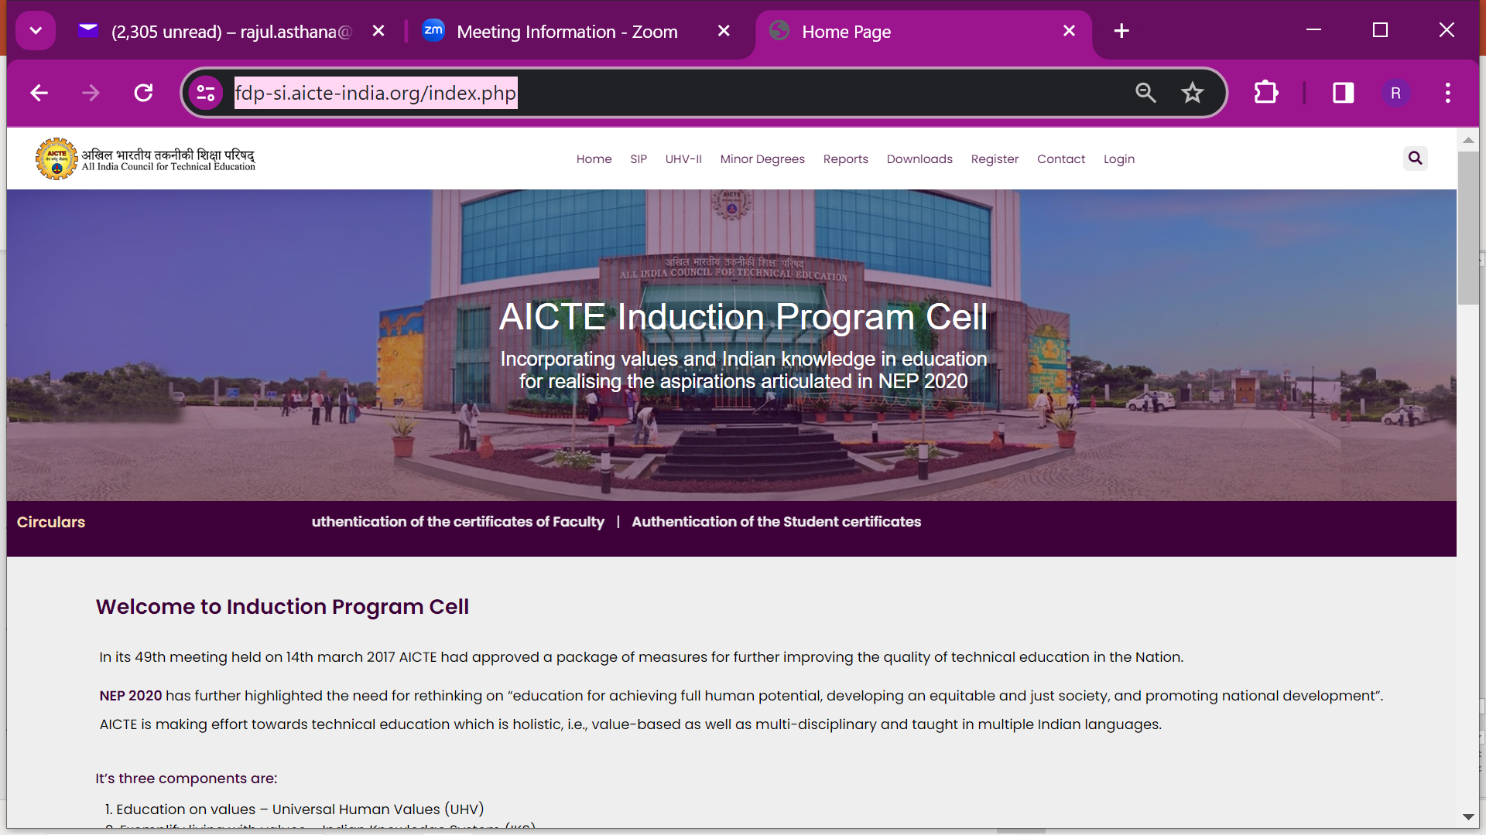
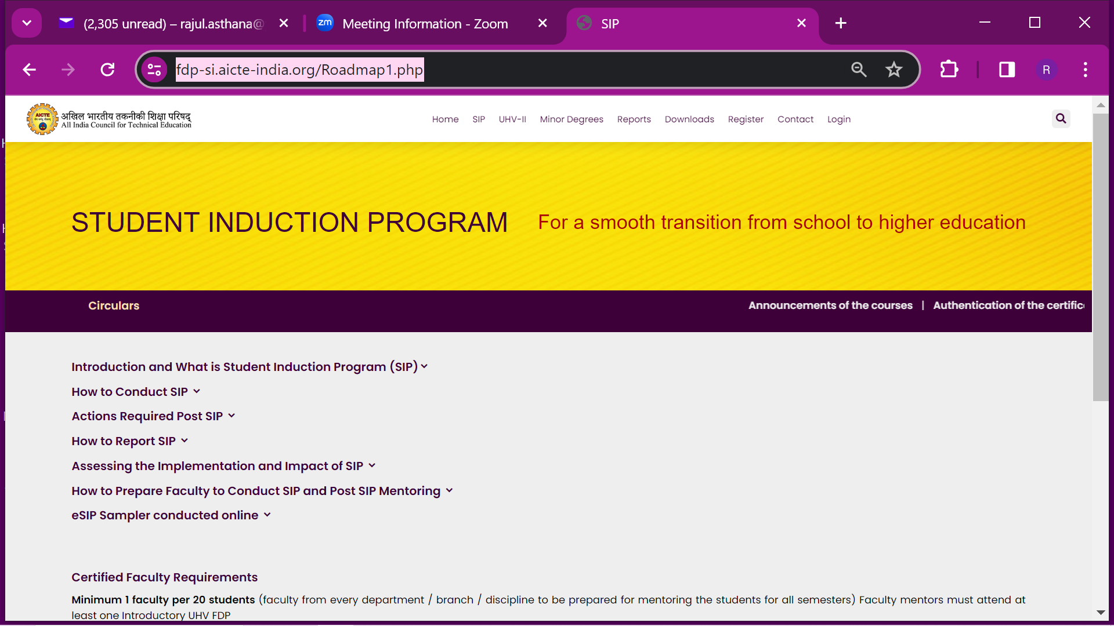
Present AICTE FDP-SI Website
https://fdp-si.aicte-india.org/index.php

Slide 32
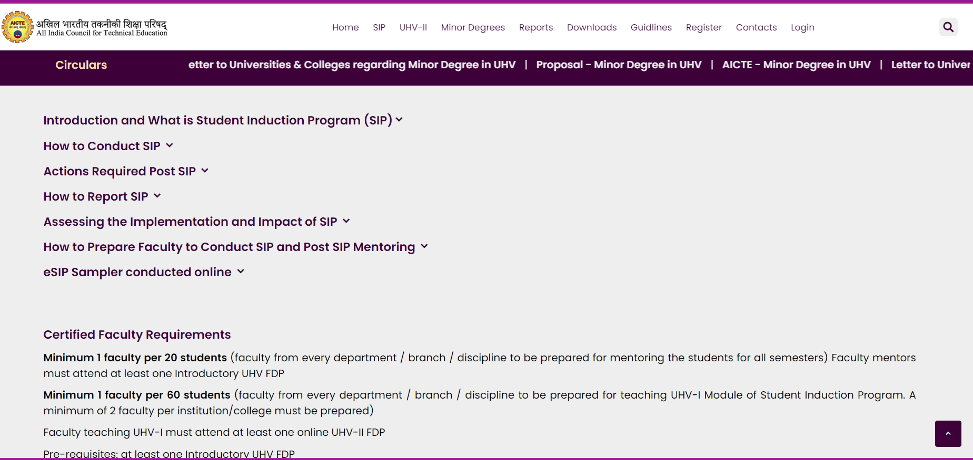
New AICTE FDP-SI Website (under Development)

Slide 33
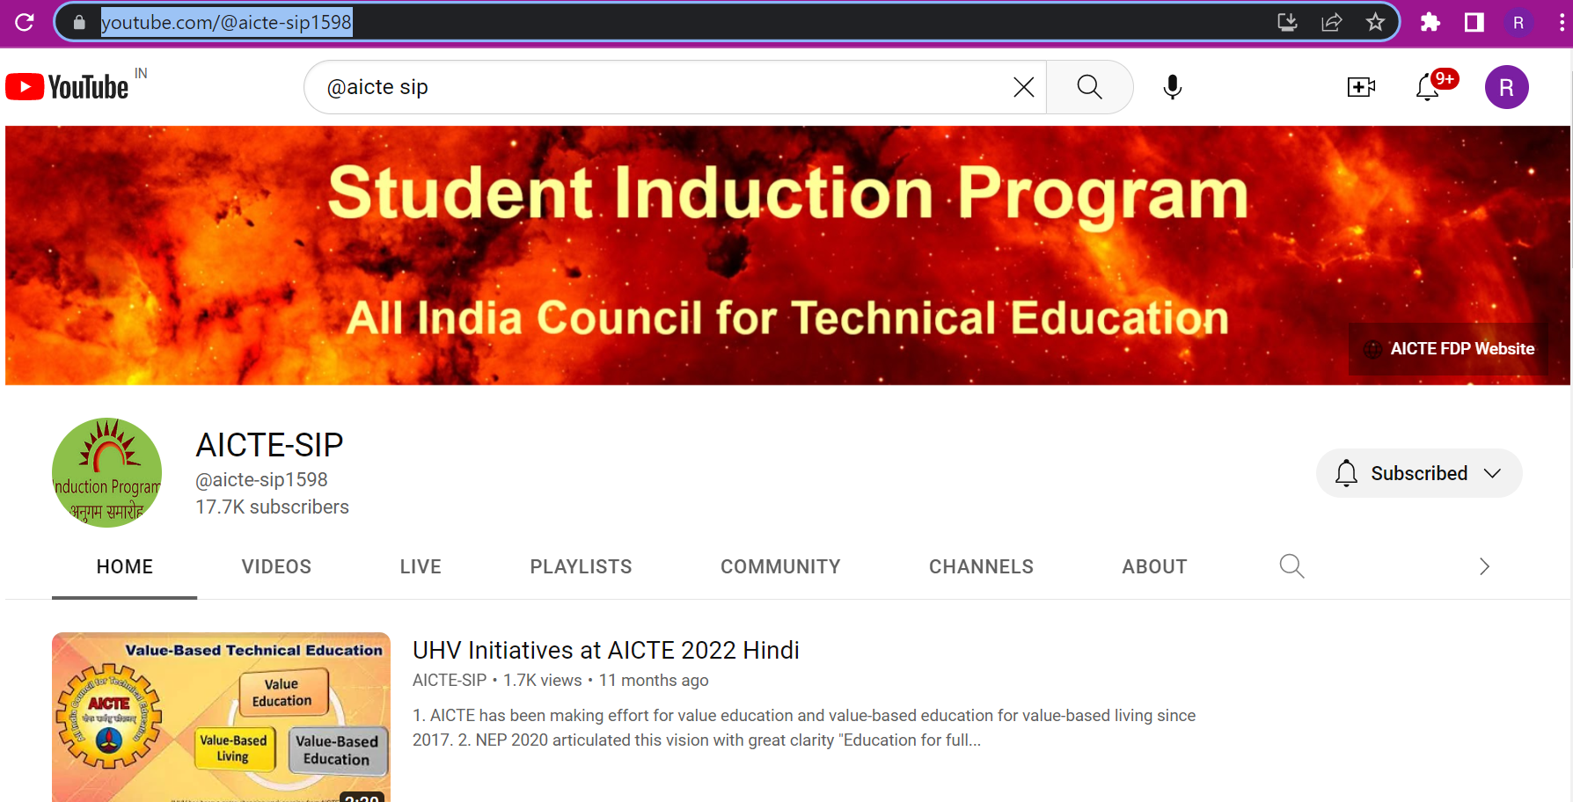
SIP YouTube Channel

Slide 34
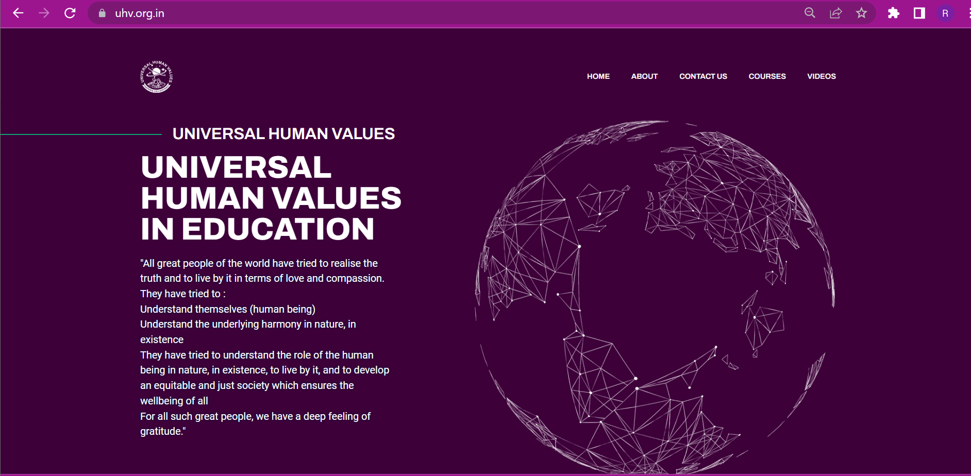
UHV Website

Slide 35
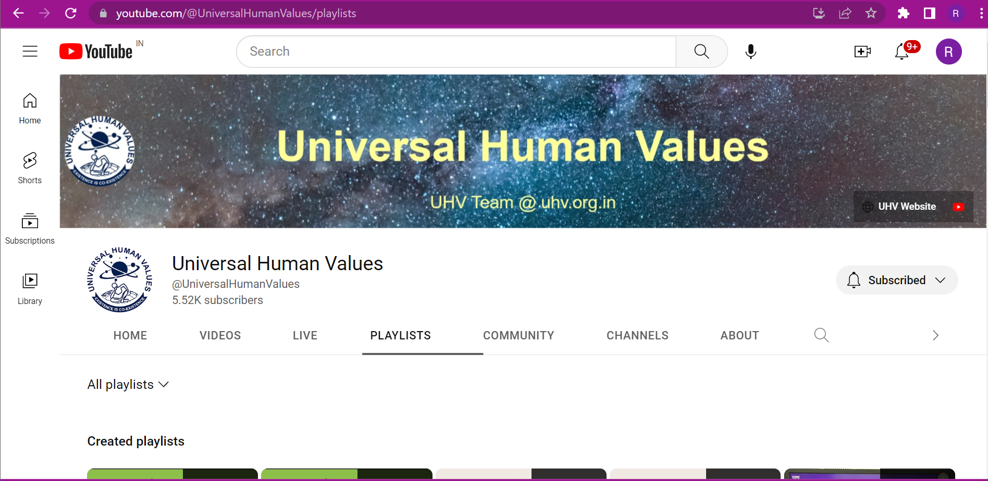
UHV YouTube Channel

